Slide 1
Blazor
An experimental .NET framework for the browser
Brian Jablonsky

Slide 2

About Me
Brian Jablonsky
@brian_jablonsky
https://www.brianjablonsky.com/
https://github.com/bjablonsky
.NET Developer
8+ years of professional experience
Co-organizer of NYC .NET Dev User Group

Slide 3
Overview
What is Blazor?
WebAssembly Crash Course
How Blazor Works
Why?
Features
Roadmap
FAQ
Code Examples
Questions

Slide 4

DANGER, WILL ROBINSON!
Blazor is still experimental!(*)
0.1.0 was released March 22, 2018
Current version is 0.8.0 released February 5, 2019
*(Client-size Blazor is still considered experimental. Server-side Blazor, renamed to Razor Components, will ship with .NET Core 3)

Slide 5
What is Blazor?
A .NET web framework that runs in the browser
Use C#/Razor to author
Runs on a .NET runtime implemented in WebAssembly
Browser + Razor = Blazor

Slide 6
WebAssembly Crash Course
WebAssembly (wasm) is a binary instruction format for a stack-based virtual machine
New type of code that can be run in a browser
Developed out of performance problems from JavaScript

Slide 7
WebAssembly Crash Course
WebAssembly Goals:
Fast, efficient, and portable
Wasm code can be executed at near-native speed in the browser
Readable and debuggable
Wasm code is a low-level assembly language but is in a human-readable text format
Secure
Designed to run in a safe, sandboxed execution environment like JavaScript in the browser

Slide 8
WebAssembly Crash Course
The web platform consists of two parts:
A virtual machine to run code
Set of APIs to control the browser
Traditionally, the browser’s VM has only been able to load JavaScript
WebAssembly adds an additional VM to run a compact binary format

Slide 9
WebAssembly Crash Course
WebAssembly is not meant to replace JavaScript
Intended to be a compilation target of source languages
WebAssembly can’t directly access the DOM
C/C++/C# source code
wasm module
HTML
Wasm compiler
JavaScript “glue” code

Slide 10
How Blazor Works
C# and Razor code files are compiled into .NET assemblies
Assemblies and .NET runtime are downloaded on the browser
Blazor uses JavaScript to bootstrap the .NET runtime (Mono) loading the required assembly references
Blazor allows DOM manipulation/browser API calls from the .NET runtime via JavaScript interoperability

Slide 11
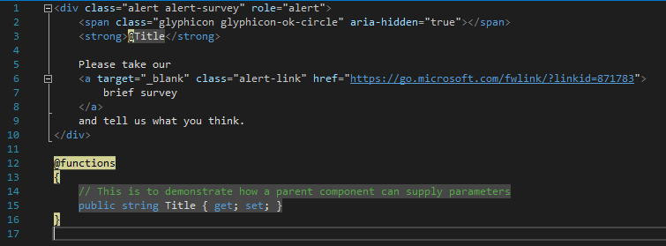
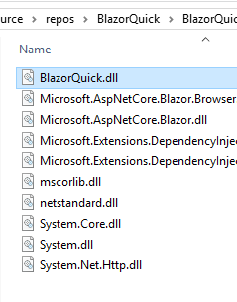
How Blazor Works
C# and Razor code files are compiled into .NET assemblies

Slide 12
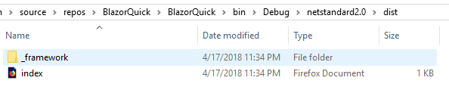
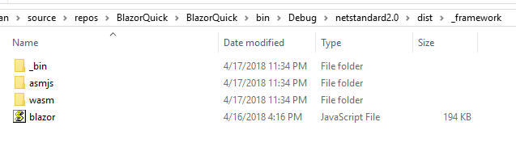
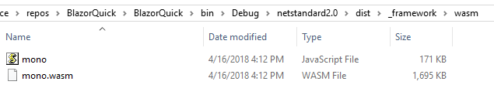
How Blazor Works
Assemblies and .NET runtime are downloaded on the browser

Slide 13
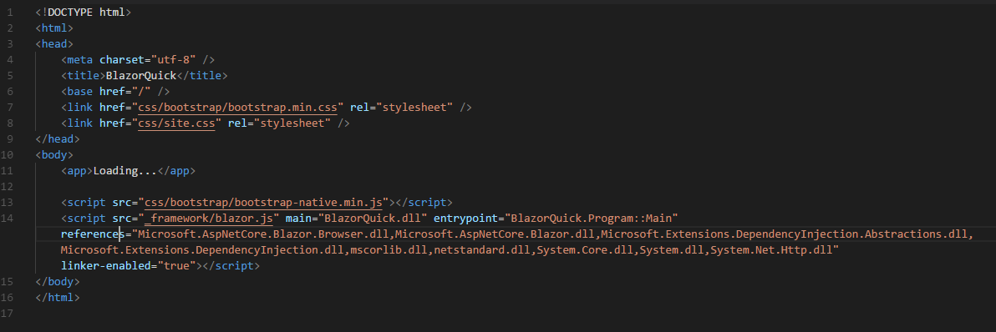
How Blazor Works
Blazor uses JavaScript to bootstrap the .NET runtime loading the required assembly references

Slide 14
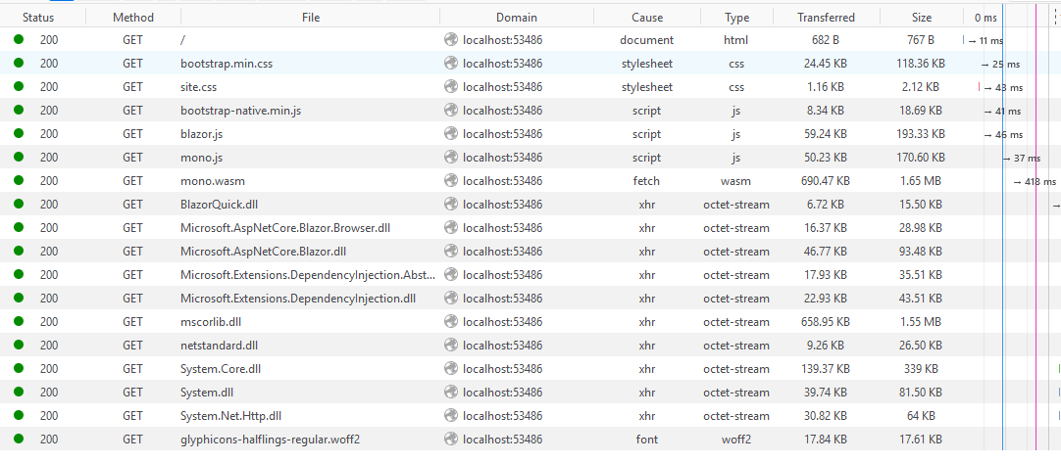
How Blazor Works
Blazor uses JavaScript to bootstrap the .NET runtime loading the required assembly references

Slide 15
How Blazor Works
Blazor allows DOM manipulation/browser API calls from the .NET runtime via JavaScript interoperability
C#
Render Tree
Blazor JavaScript
Change DOM
DOM
C#
Event Trigger
Process Event
Blazor JavaScript
Change DOM
DOM
UI Differences

Slide 16
Demo

Slide 17
Setup
WebAssembly compatible browser
https://platform-status.mozilla.org/#web-assembly
.NET Core 3.0 Preview 2 SDK
3.0.100-preview-010184
https://dotnet.microsoft.com/download/dotnet-core/3.0
Visual Studio 2019 Preview 2
https://visualstudio.com/preview
Blazor Language Services extension
https://go.microsoft.com/fwlink/?linkid=870389

Slide 18
Setup
Visual Studio Code/command line
dotnet new -i Microsoft.AspNetCore.Blazor.Templates::0.8.0-preview-19104-04
dotnet new blazor
dotnet build
(current bug fix: https://github.com/dotnet/sdk/issues/2948)
cd ..
dotnet new console -o ConsoleApp1
cd -
dotnet run

Slide 19
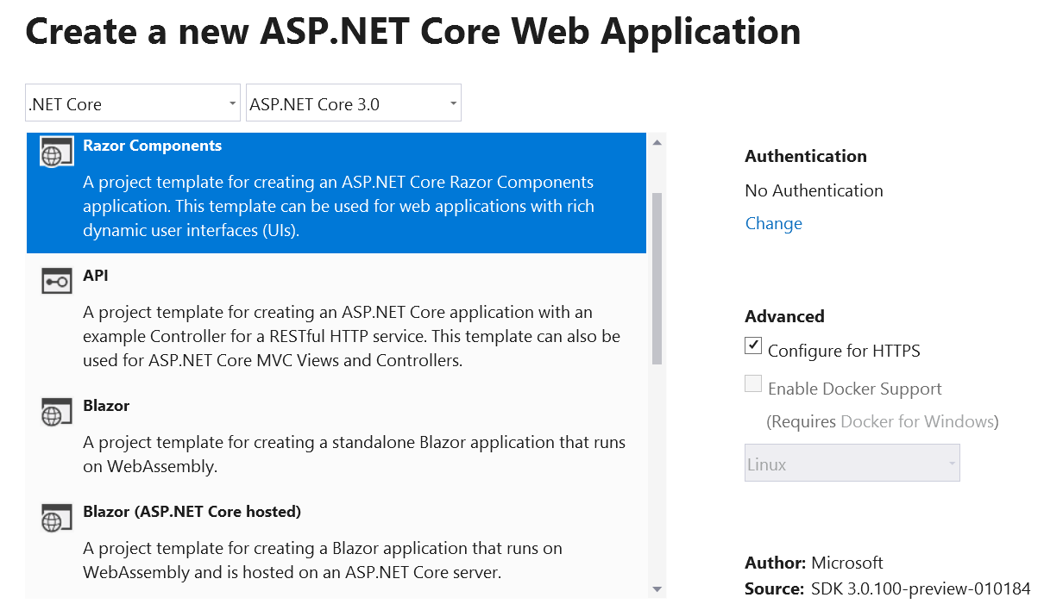
Setup
Visual Studio

Slide 20
Code Example
New Project

Slide 21
Why?
Full Stack development using C# and .NET
.NET advantages:
High Performance
Scalability
Maintainability
Cross Platform
Visual Studio
Notes:
https://www.techempower.com/benchmarks/#section=data-r15&hw=ph&test=plaintext&l=hra0al

Slide 22
Features
Component model for building composable UI
Routing
Layouts
Forms and validation
Dependency injection
JavaScript interop
Live reloading in the browser during development
Server-side rendering

Slide 23
Features
Full .NET debugging both in browsers and in the IDE
Rich IntelliSense and tooling
Ability to run on older (non-WebAssembly) browsers via asm.js
Publishing and app size trimming

Slide 24
Roadmap
March 2017 – WebAssembly announces 1.0
August 2017 – Mono announces prototype WebAssembly
February 2018 – Blazor is publicly available

Slide 25
Roadmap
March 22, 2018 – Blazor 0.1.0 is released
Support @page with custom route template on components
Standard BCL HttpClient
Add ASP.NET Core hosted project template
VS Blazor editor
Basic JavaScript interop
Publishing
Development host
Compilation

Slide 26
Roadmap
April 17, 2018 – Blazor 0.2.0 is released
Improved event handling
Build reusable component libraries
Improved JavaScript interop

Slide 27
Roadmap
May 2, 2018 – Blazor 0.3.0 is released
Async event handlers
Component and element refs
Better encapsulation of component parameters

Slide 28
Roadmap
June 7, 2018 – Blazor 0.4.0 is released
Event payloads for common even types
Send/receive binary HTTP using HttpClient
Binding to numeric types
JS interop improvements

Slide 29
Roadmap
August 10, 2018 – Blazor 0.5.0 is released
Server-side Blazor (more on this later)
JS Interop improvements
Basic debugging in Chrome for client-side Blazor

Slide 30
Roadmap
October 2, 2018 – Blazor 0.6.0 is released
Templated components
Refactored server-side Blazor to support Azure SignalR Service
Announcement of moving server-side Blazor into .NET Core 3.0 – “Razor Components”

Slide 31
Roadmap
November 15, 2018 – Blazor 0.7.0 is released
Cascading values and parameter
Client-side debugging improvements

Slide 32
Roadmap
February 5, 2018 – Blazor 0.8.0 is released
Server-side Blazor officially called Razor Components
Support to host Razor Components in browser
Runtime improvements

Slide 33
Roadmap
Future
ASP.NET Core Razor Components (aka server-side Blazor) will ship with .NET Core 3.0 (sometime 2019)
Better debugging
Make startup/loading faster
Make code run faster

Slide 34
FAQ
Does Blazor compile my entire .NET assembly into WebAssembly?
No.
Only .NET runtime is compiled into WebAssembly.
Could be support for full static ahead-of-time compilation into WebAssembly in the future.

Slide 35
FAQ
Won’t the app size huge for the .NET runtime?
Not really.
Runs on full Mono Desktop profile right now.
Plans to reduce size by using custom profile.

Slide 36
FAQ
Can I use Blazor without .NET backend?
Yup.
Can be deployed as set of static files.

Slide 37
Demos

Slide 38
Blazor Project Types
Client-side Blazor – Standalone
Creates a static client-side Blazor app which can be hosted by any web server (standard JS/HTML/CSS)
Client-side Blazor – ASP.NET Core backend
Creates a client-side Blazor app which is backed by ASP.NET Core
Server-side Blazor (Razor Components)
Creates a server-side Blazor app which is backed by ASP.NET Core and renders the components on the backend providing UI updates via SignalR

Slide 39
Server-side Blazor
Traditional client-side rendering
Browser
UI Thread
Blazor

Slide 40
Server-side Blazor
Server-side rendering
Browser
UI
Web Worker
Blazor

Slide 41
Server-side Blazor
Server-side rendering using SignalR
Browser
dotnet
ASP.NET Core
SignalR
Blazor

Slide 42
Server-side Blazor
Trade-offs
Latency
No Offline Support
Scalability

Slide 43
Components
Fundamental building block of web apps
Components are self-contained UI
Includes HTML and logic to inject data or respond to events
They can be nested, reused, and shared between projects
Written using C#/Razor and HTML

Slide 44
Code Example
Components

Slide 45
Layouts
Layouts are really just components
Defined in a Razor template
Must implement the Microsoft.AspNetCore.Blazor.Layouts.ILayoutComponent component
Adds a Body property that contains the content to be rendered
Allows for nested layouts

Slide 46
Code Example
Layouts

Slide 47
Routes
Handles internal routing of pages
Router is configured in App.cshtml
Uses the @Page directive defined in the Pages
Can have multiple routes
Can contain parameters

Slide 48
Code Example
Routes

Slide 49
Data Binding
Supports one-way and two-way data binding
Binding using the bind= attribute
Support for binding data types:
Int, float, long, double, decimal
String
DateTime
Enums
Bool
If you need another type, you must provide a getter/setter.

Slide 50
Code Example
Data binding

Slide 51
JavaScript Interop
Supports calling JavaScript from inside Blazor
Blazor uses registered functions
Supports calling C# from JavaScript

Slide 52
Code Example
JavaScript Interop

Slide 53
Questions
?

Slide 54
Additional Information
Blazor GitHub
https://github.com/aspnet/AspNetCore/tree/master/src/Components
Blazor.net
http://blazor.net/docs/
Steve Sanderson’s Intro to Blazor
http://blog.stevensanderson.com/2018/02/06/blazor-intro/
Learn Blazor
http://learn-blazor.com/

